Slide 1
System Testing with Selenium 2

Slide 2
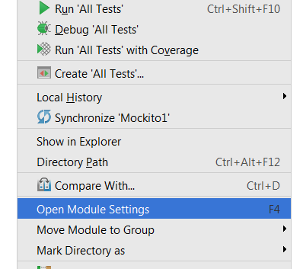
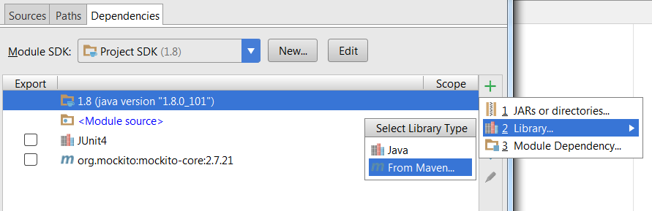
IntelliJ Setup

Slide 3
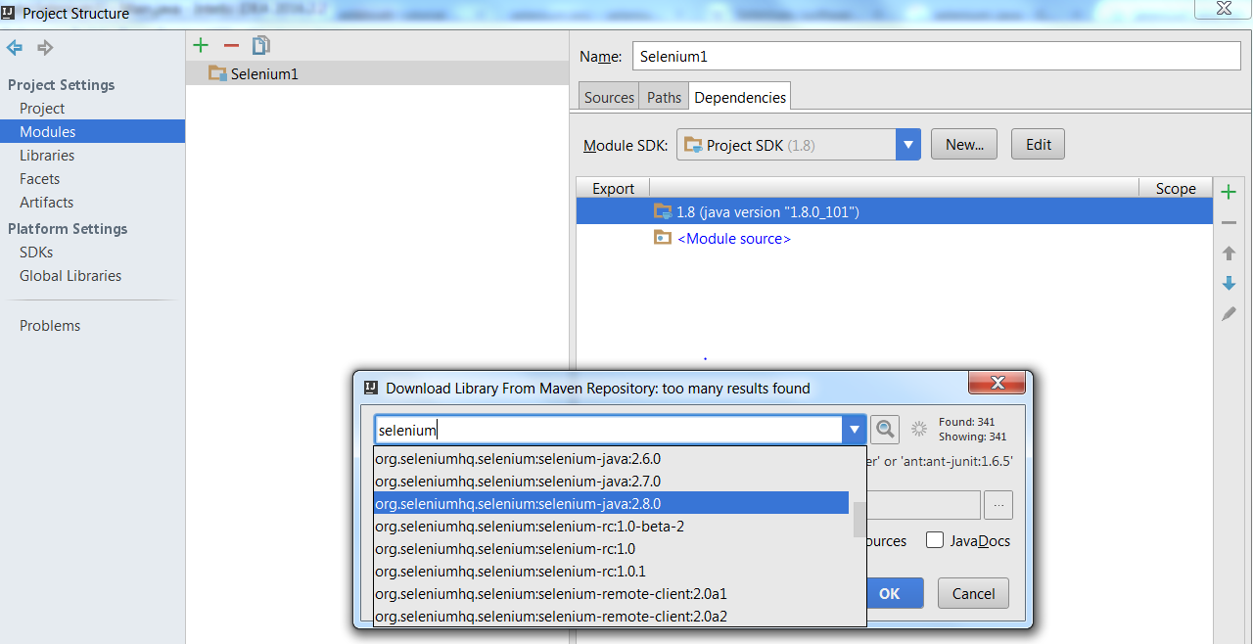
IntelliJ Setup

Slide 4
Locating elements using findElements
@Test
public void testFindElements() {
//Get all the links displayed on Page
List<WebElement> links =
driver.findElements(By.tagName("a"));
//Verify there are four links displayed on the page
assertEquals(4, links.size());
//Iterate though the list of links and print
//target for each link
for(WebElement link : links)
System.out.println(link.getAttribute("href"));
}

Slide 5
The findElements() method returns all the elements matching with the locator specified as a list of WebElements.
In Java, we can use the List class to create an instance of list of WebElements.
List<WebElement> links = driver.findElements(By.tagName("a"));
The size() method of the List class will tell us how many elements are there in the
list. assertEquals(4, links.size());
We can iterate using this list in the following way, getting a link and printing its target value:
for(WebElement link : links)
System.out.println(link.getAttribute("href"));

Slide 6
Finding a link by its text
Selenium WebDriver's By class provides the linkText() method to locate links using the text displayed for the link. In the following example, we will locate the GMail link:
WebElement gmailLink = driver.findElement(By.linkText("GMail")); assertEquals("http://mail.google.com/", gmailLink.getAttribute("href"));

Slide 7
Finding a link by partial text
WebElement inboxLink = driver.findElement(By.partialLinkText("Inbox")); System.out.println(inboxLink.getText());

Slide 8
Locating by Tag Name
WebElement loginButton =
driver.findElement(By.tagName("button")); loginButton.click();
Take another example where we want to count how many rows are displayed in <table>. We can do this in the following way:
WebElement table =
driver.findElement(By.id("summaryTable")); List<WebElement> rows = table.findElements(By.tagName("tr")); assertEquals(10, rows.size());

Slide 9
CSS Review
http://en.wikipedia.org/wiki/Cascading_Style_Sheets.
https://code.tutsplus.com/tutorials/the-30-css-selectors-you-must-memorize--net-16048
CSS Diner: https://flukeout.github.io/

Slide 10
CSS – Absolute Paths
WebElement userName = driver.findElement(By.cssSelector("html
body div div form input"));
You can also use the previous selector in the following way by describing the direct parent to child relationships with > separator:
WebElement userName =
driver.findElement(By.cssSelector("html > body > div > div > form > input"));

Slide 11
WebElement loginButton = driver.findElement(By.cssSelector("input.login"));
WebElement loginButton = driver.findElement(By.cssSelector(".login"));
WebElement userName = driver.findElement(By.cssSelector("input#username"));
WebElement userName = driver.findElement(By.cssSelector("#username"));
WebElement userName = driver.findElement(By.cssSelector("input[name=username]"));

Slide 12
WebElement previousButton = driver.findElement(By.cssSelector("img[alt='Previous']"));
WebElement previousButton = driver.findElement(By.cssSelector("input[type='submit'][value='Login']"));
List<WebElement> imagesWithAlt = driver.findElements(By.cssSelector("img[alt]"));
List<WebElement> imagesWithoutAlt = driver.findElements(By.cssSelector("img:not([alt])"));

Slide 13
Performing partial match on attribute values
^= -starting with- input[id^='ctrl']
$= -ending with- input[id$='_userName']
*= -containing- input[id*='userName']

Slide 14
Locating elements using XPath
Used for locating nodes in an XML document
Elements can be located in absolute terms or a relative position to an element that has a specified id or name attribute
Can locate elements via attributes other than id or name
Starts with “//”
WebElement userName = driver.findElement(By.xpath("html/body/div/div/form/input"));
assuming it is the first <input> element in the DOM:
WebElement userName = driver.findElement(By.xpath("//input"));

Slide 15
Let’s start Project
Please remember this is a hard deadline project
5 points off each day you are late

